Slide 1
Performance Analysis of GCC Compiler Optimizations
CSCI 5593
Aishwarya Mulkalwar
Courtney Peverley
Stefani Moore

Slide 2
How do compiler optimizations affect program compilation time and runtime, as well as the underlying architecture?

Slide 3
Compiler:
A language parser that converts one programming to another
For our purposes, this will be the conversion of a high-level language (like C++) to a target low-level language
Notes:
Front end:
Lexical analysis (divide into words and categorize the words)
Syntax analysis (arrange words in parse tree)
Intermediate representation generation (create machine-independent representation of program)
Back-end:
Register allocation: assign variable names a register in target machine code
Machine code generation: produce assembly code for specific machine architecture
Assembly and linking

Slide 4
Compiler Optimization Goals:
Preserve Program Meaning
Improve Source Program
Minimize execution time
Notes:
Goal of compilers: transform source code into some sort of intermediate representation
Optimization:
Each optimization technique applied independently
Intermediate representation passed through optimizer several times

Slide 5
The GCC Compiler

Slide 6
GCC
Widely-used
7 levels of optimization
3 main ones: O1, O2, O3
Machine-specific options
The Big Kahuna
Notes:
The language-independent component of GCC includes the majority of the optimizers, as well as the “back ends” that generate machine code for various processors
When you invoke GCC, it normally does preprocessing, compilation, assembly and linking. The “overall options” allow you to stop this process at an intermediate stage. For example, the -c option says not to run the linker. Then the output consists of object files output by the assembler.

Slide 7

O0: The default
No Optimization
No rearrangement
Useful while debugging a program.
Pete, the Unoptimized Snail: We love him, but he’s very slow
Notes:
At this optimization level GCC does not perform any optimization and compiles the source code in the most straightforward way possible. Each command in the source code is converted directly to the corresponding instructions in the executable file, without rearrangement. This is the best option to use when debugging a program and is the default if no optimization level option is specified.

Slide 8
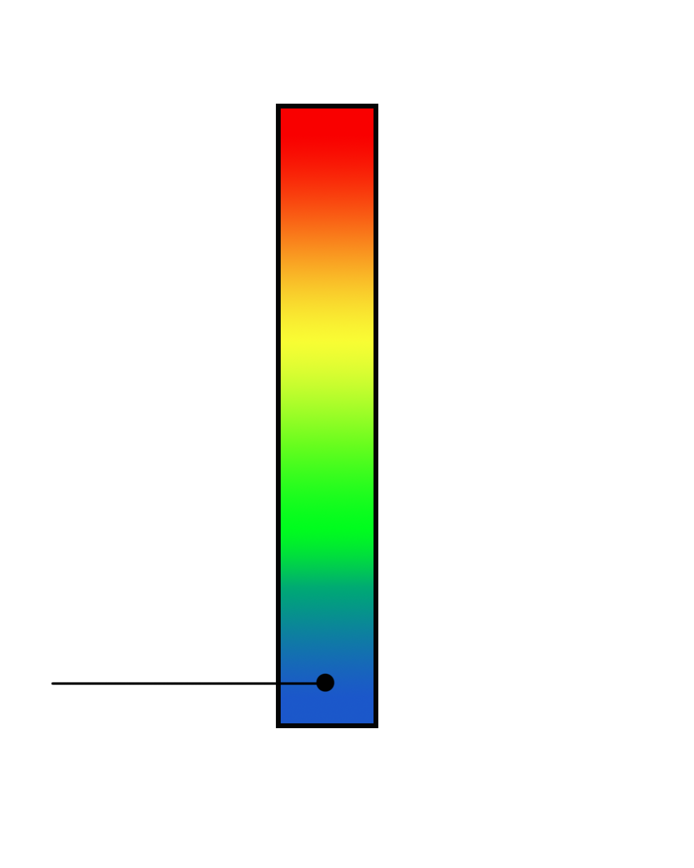
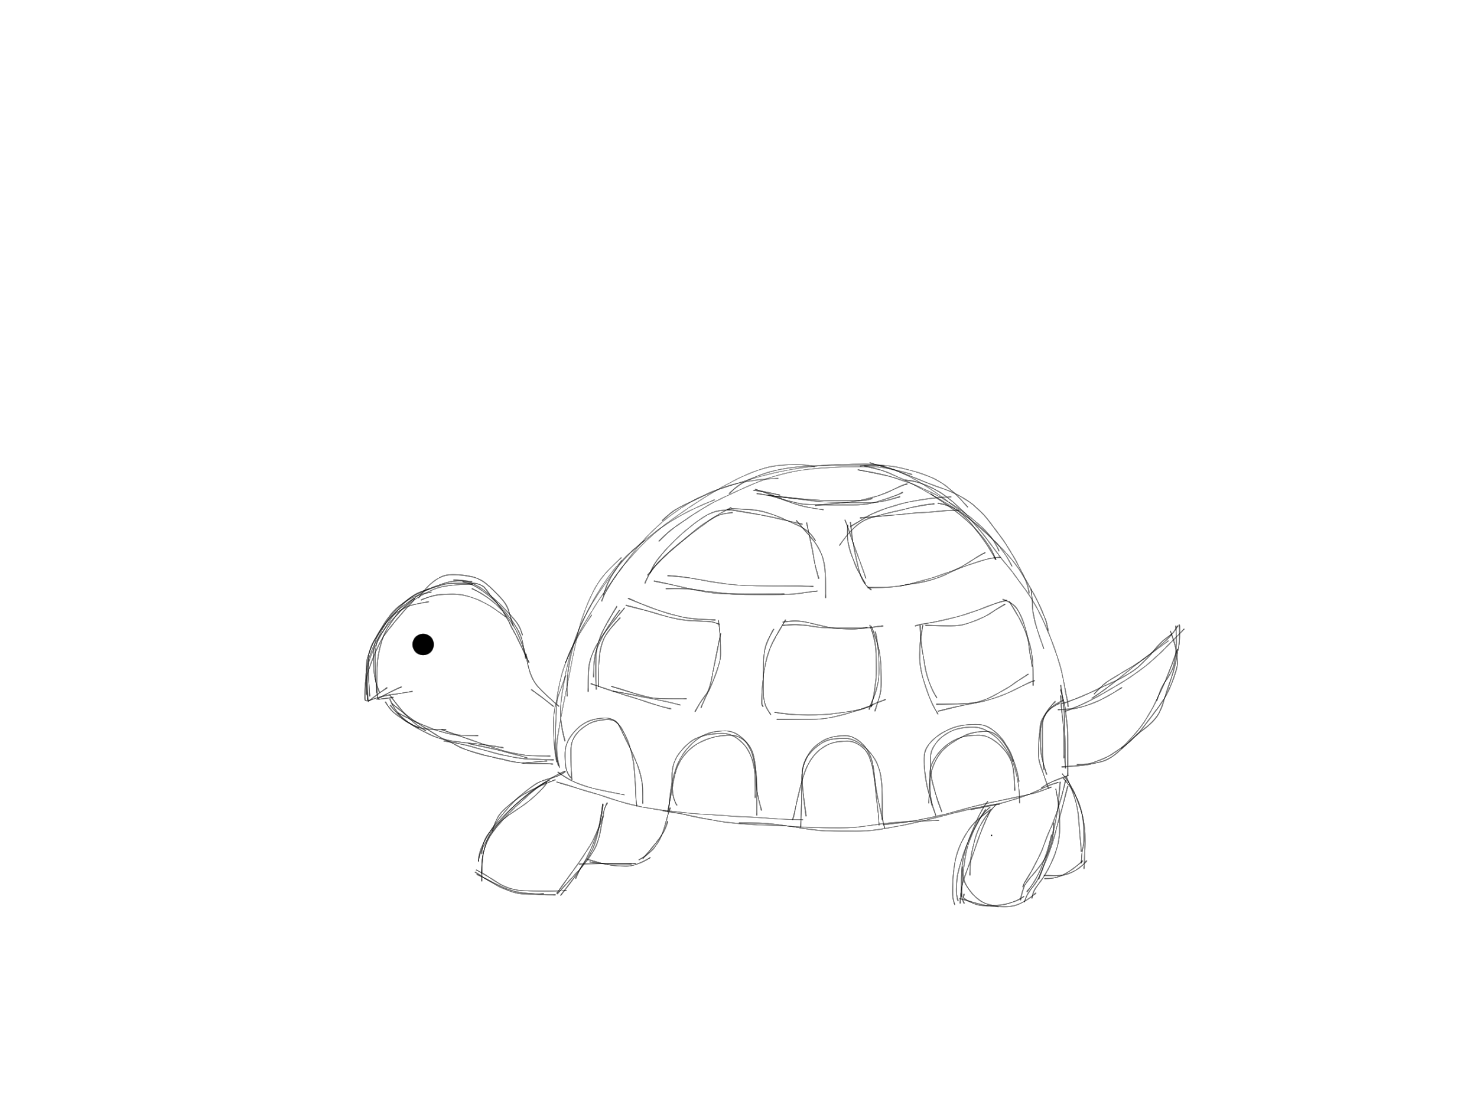
-O1: The Basics
The Animal Scale of Runtime Quickness
Takes more time, memory than no optimizations
Effects:
Reduces code size
Reduces execution time
Keeps compilation time relatively low
Notes:
Optimizing compilation takes somewhat more time, and a lot more memory for a large function.
With -O, the compiler tries to reduce code size and execution time, without performing any optimizations that take a great deal of compilation time.
The purpose of the first level of optimization is to produce an optimized image in a short amount of time. These optimizations typically don't require significant amounts of compile time to complete. Level 1 also has two sometimes conflicting goals. These goals are to reduce the size of the compiled code while increasing its performance. The set of optimizations provided in -O1 support these goals, in most cases.
-O turns on the following optimization flags:
Shrink-wrap:
Emit function prologues only before parts of the function that need it, rather than at top of function
Function prologue (in assembly): few lines at beginning that prepare stack and registers for use within the function

Slide 9
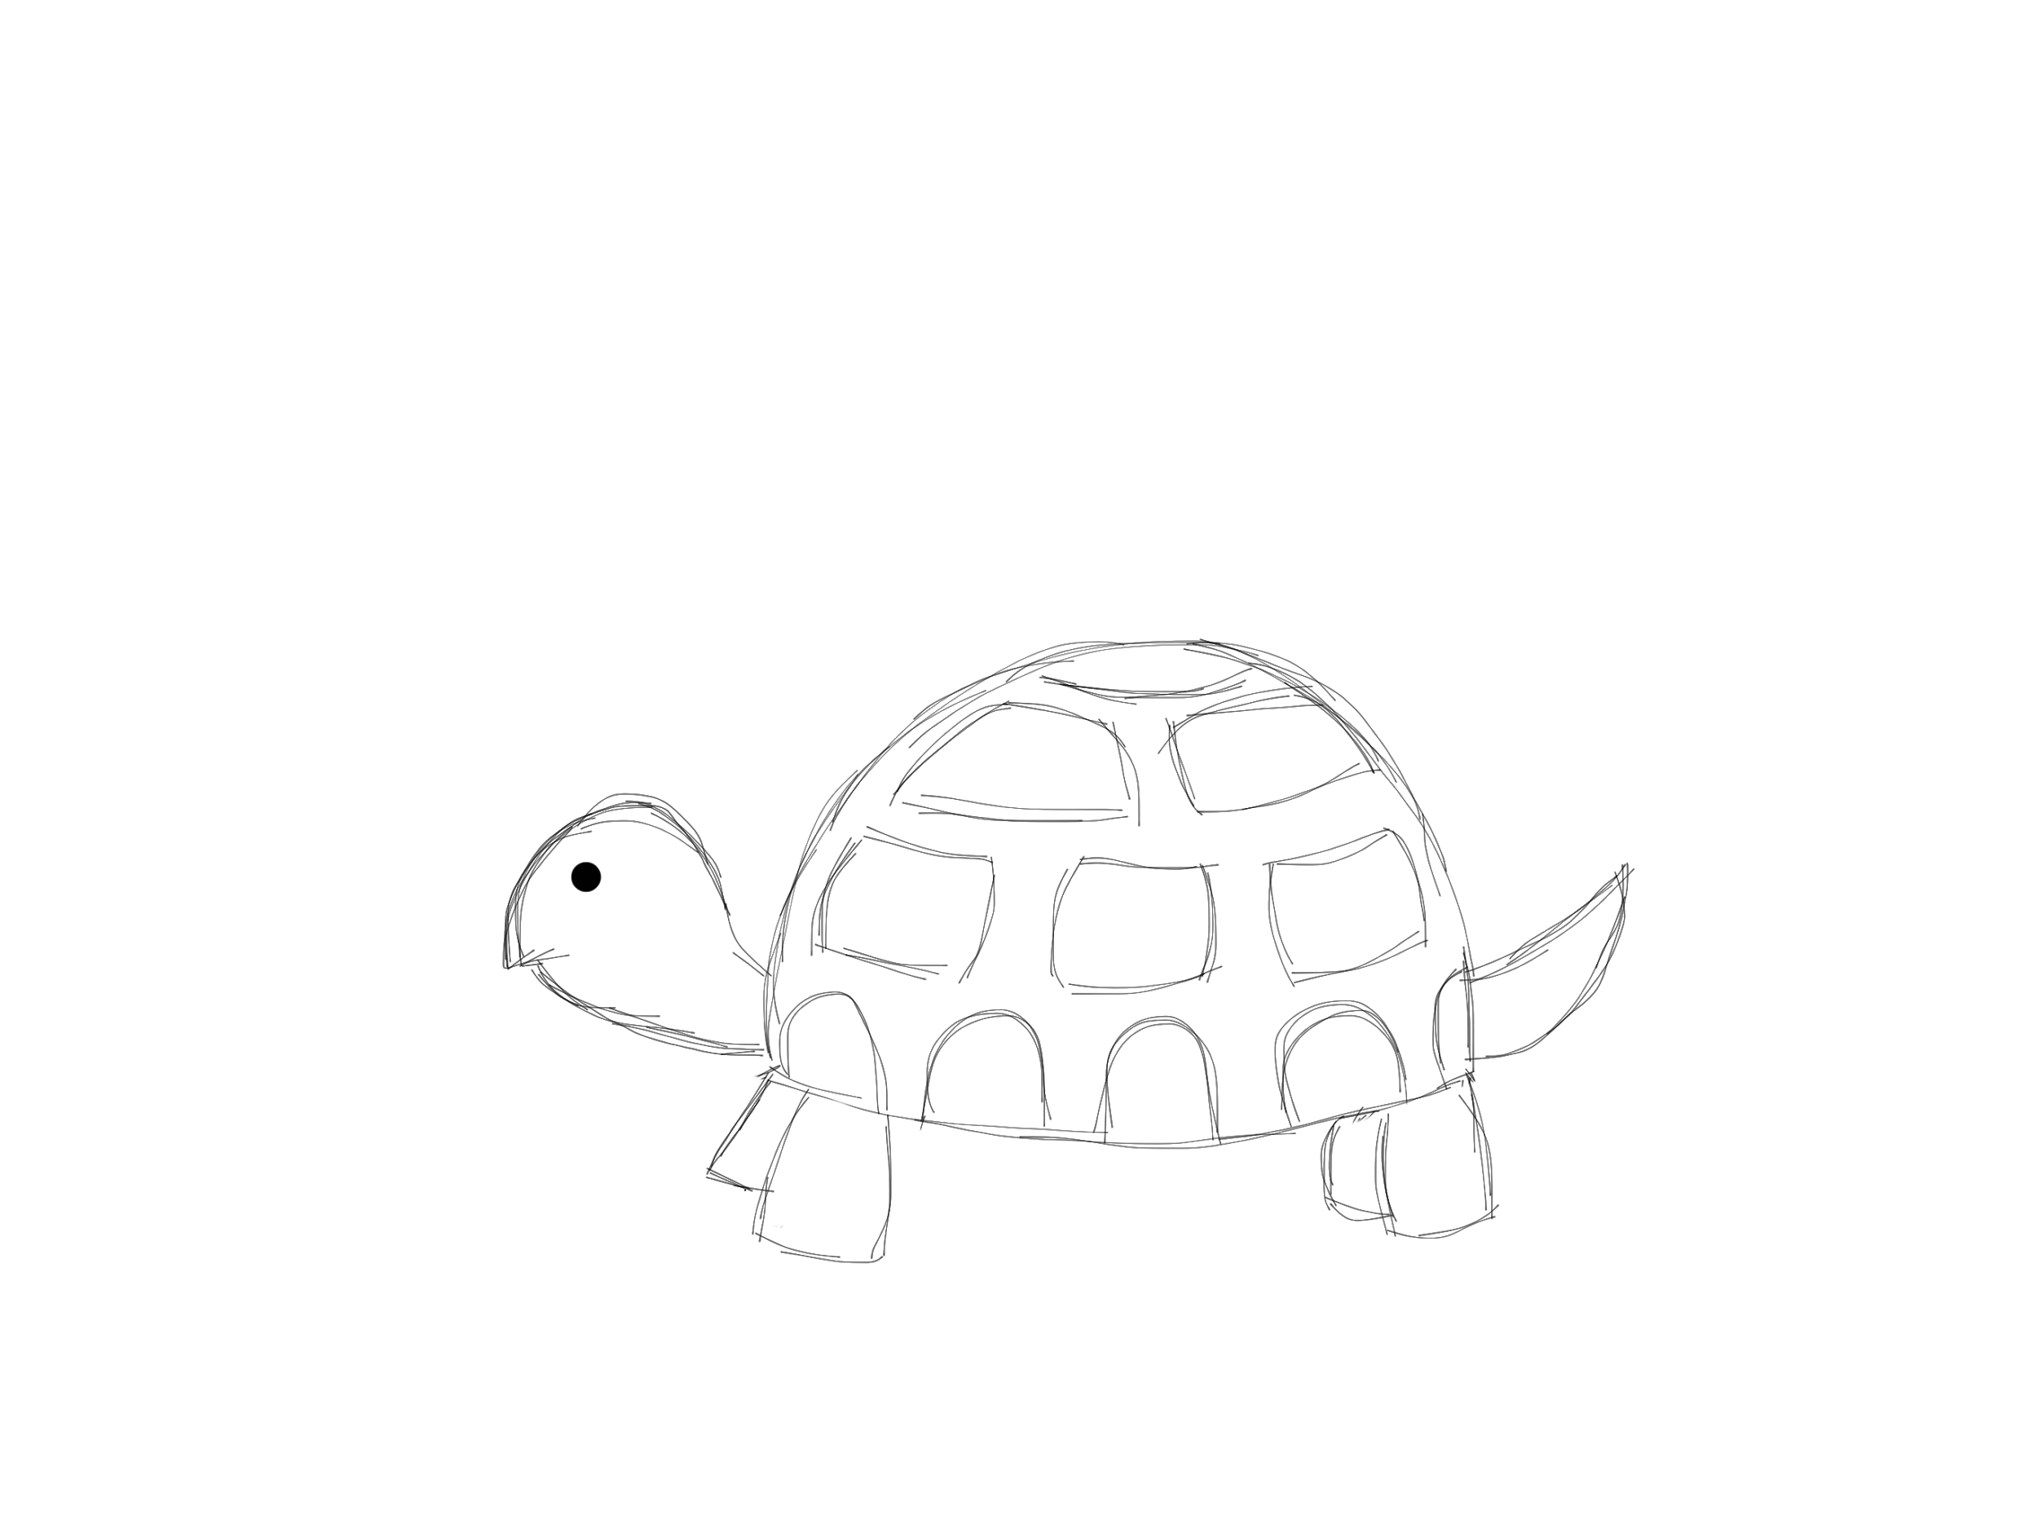
-O1: Some Optimizations
The Animal Scale of Runtime Quickness
merge-constants:
- Attempt to merge Identical constants.
loop-optimize:
Move constant expression out of loops.
Simplify exit test conditions and do loop unrolling.
if-conversion:
Attempt to transform conditional jumps into branch less equivalent.

Slide 10
-O1: Tree Optimizations
The Animal Scale of Runtime Quickness
tree-dce:
Perform dead code elimination on trees.
- tree-dominator-opt:
Perform a variety of simple scalar cleanup operation.
Redundancy elimination.

Slide 11
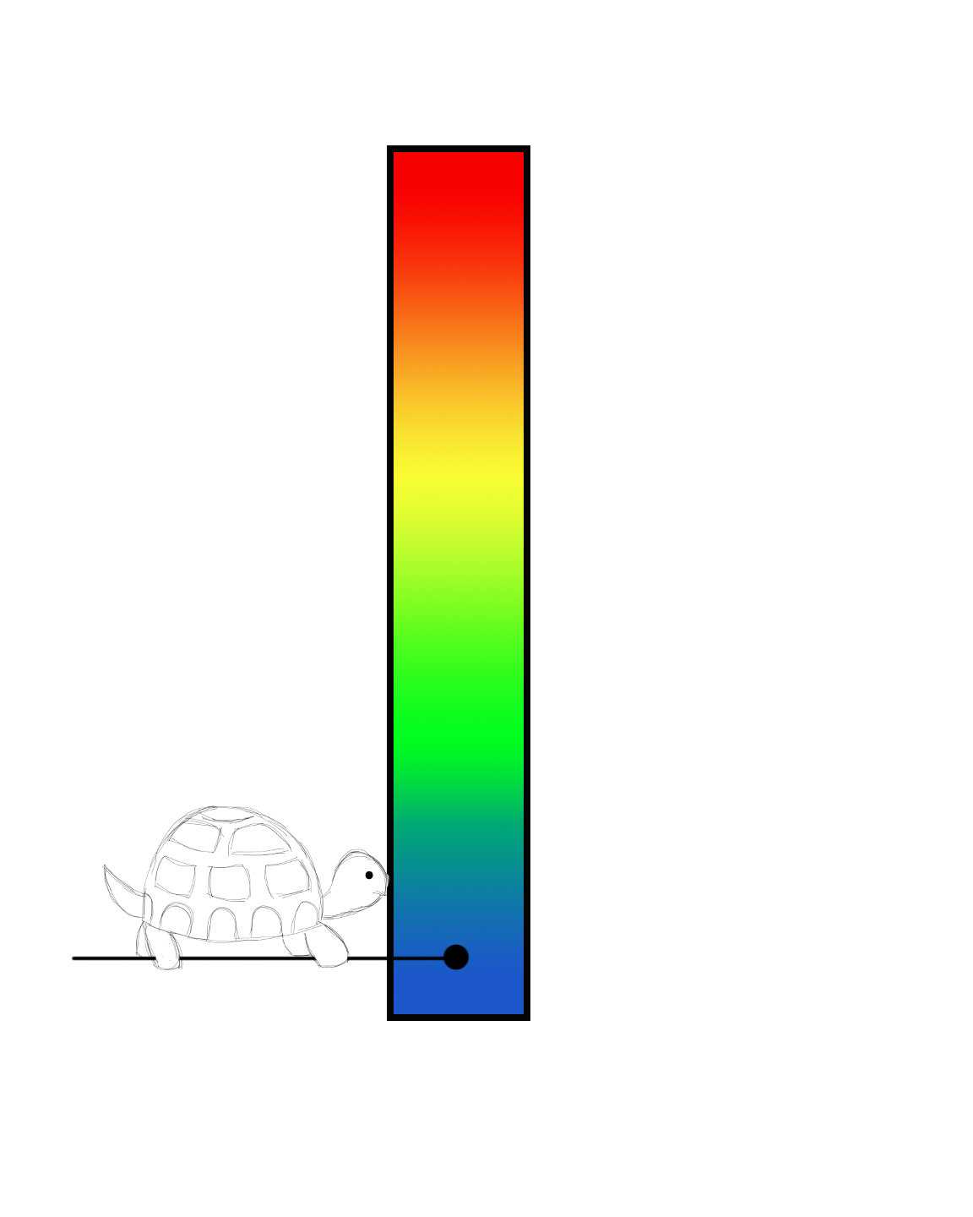
-O1: Interprocedural Analysis (IPA)
The Animal Scale of Runtime Quickness
Goals:
lessen the number of duplicate calculations
make efficient use of memory
simplify loops
ipa-profile: profile propagation
propagate function attributes
If a function is cold (not likely to be executed), any function called only within this is also deemed cold
cold functions optimized for size
Notes:
Ipa-pure-const, ipa-profile, ipa-reference
Ipa: interprocedural analysis
Ipa-pure-const marks functions as either constant or pure
Also sets variant that are allowed to loop indefinitely
PURE: function doesn’t modify global memory; CONST: function doesn’t read/modify any global memory
Ipa-reference: gathers info about how variables whose scope is confined to the compilation unit are used (?)
First, analyze each function and static variable initialization to determine which variables are either read, written, or have their address taken
Any local static variable that has its address taken is removed from consideration
Then, transitive closure (?) of this info is performed over the call graph (?) to determine the worst case set of side effects of each call
Later, local and global sets are examined to make the call clobbering (?) less traumatic, promote some statics to registers, and improve aliasing
TLDR: discover which static variables don’t escape the compilation unit

Slide 12
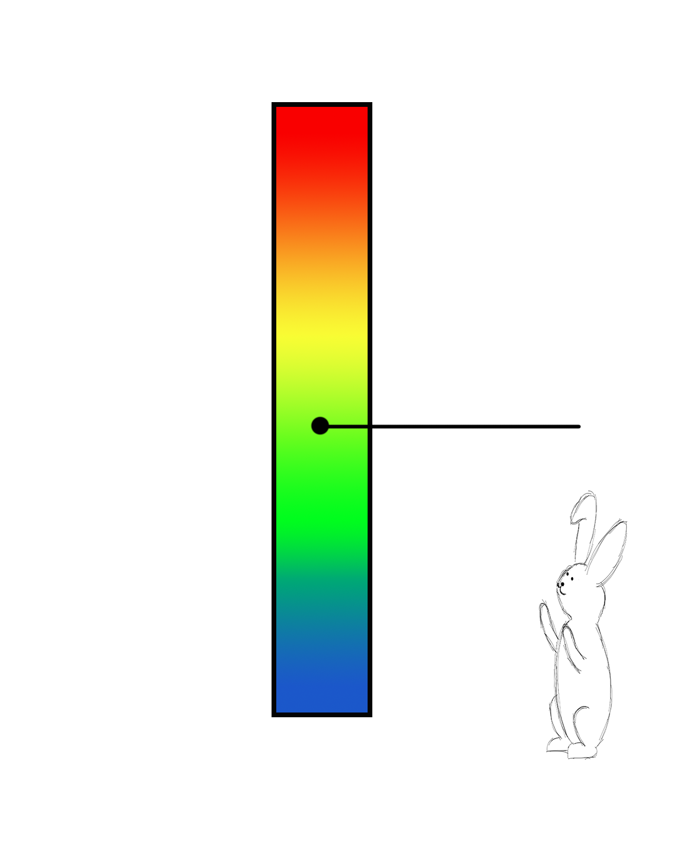
-O2: A Little Bit More
The Animal Scale of Runtime Quickness
add more optimizations
avoid those with space-speed tradeoff
Effects:
increases compilation time
improves code performance
Notes:
Space-speed tradeoff: sacrifice an increase in space for some added speed
Align stuff will increase size, but ideally not prohibitively so

Slide 13
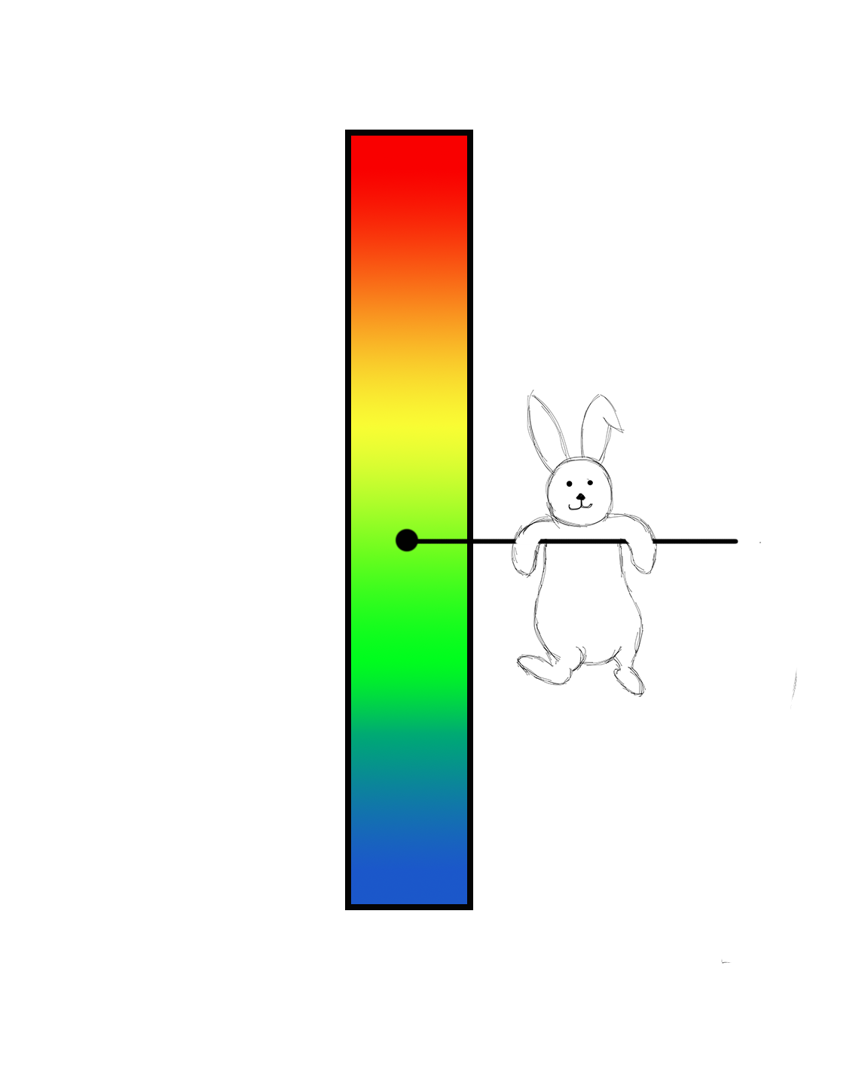
-O2: Aligning functions, jumps, etc
The Animal Scale of Runtime Quickness
takes advantage of processor fetching patterns
align-functions:
aligns the start of functions to next power of two
align-labels/jumps:
aligns branch targets (those reached via jumping for align-jumps) to power of two
align-loops:
align loops to next power of two
works best if loops are executed many times
Notes:
All of these increase code size by adding nops.
Processors fetch instructions in groups of powers of two.

Slide 14
-O2: Aligning functions, jumps, etc
The Animal Scale of Runtime Quickness
takes advantage of processor fetching patterns
align-functions:
aligns the start of functions to next power of two
align-labels/jumps:
aligns branch targets (those reached via jumping for align-jumps) to power of two
align-loops:
align loops to next power of two
works best if loops are executed many times
Notes:
Maximum allowed bytes to skip (power of two) = 65536 for align-labels and jumps

Slide 15
-O2: Aligning functions, jumps, etc
The Animal Scale of Runtime Quickness
takes advantage of processor fetching patterns
align-functions:
aligns the start of functions to next power of two
align-labels/jumps:
aligns branch targets (those reached via jumping for align-jumps) to power of two
align-loops:
align loops to next power of two
works best if loops are executed many times
Notes:
Align-loops works best if executed many times because of the padding - if only executing once or a couple times, you get a performance penalty because you have to deal with all the no-ops in padding with little to no actual payoff

Slide 16
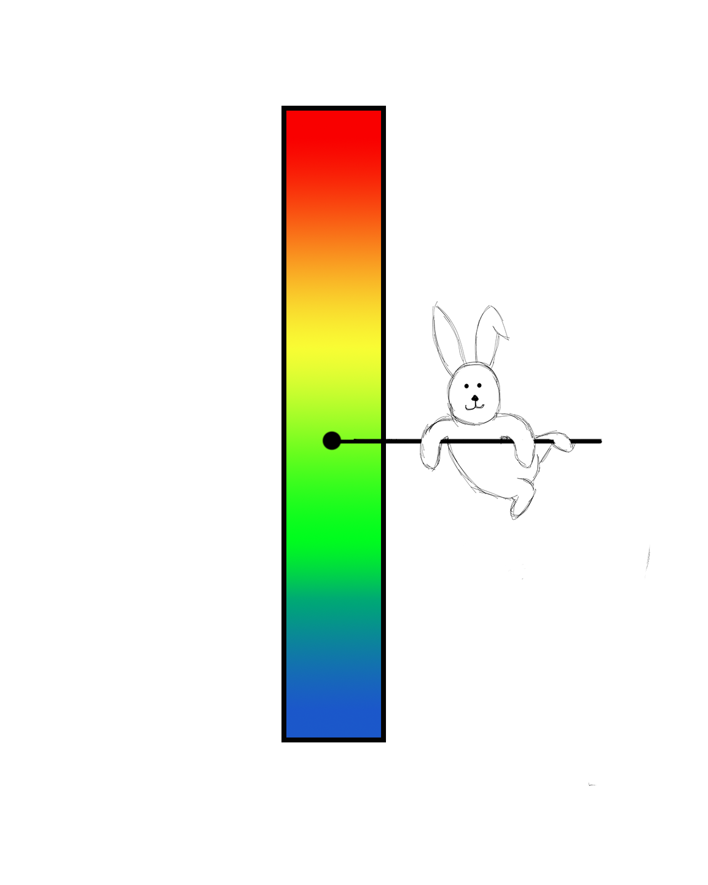
-O2:Common Subexpression Elimination
The Animal Scale of Runtime Quickness
look for repeated expressions that evaluate to same value & potentially replace with single variable
Local: within single block
Global: entire procedure
rerun-cse-after-loop:
performs CSE after loop optimizations have been performed
Notes:
Additional cse optimization tags:
cse-follow-jumps: scan through jump instructions when target isn’t reached by any other path
cse-skip-blocks: follow jumps that conditionally skip over blocks
gcse: performs global CSE pass
gcse-lm: global CSE attempts to move loads that are only killed by stores themselves
Change load/store sequence within a loop to a load outside a loop and a copy/store within the loop

Slide 17

-O2: IPA Additions
The Animal Scale of Runtime Quickness
ipa-cp: constant propagation
substitute constant values in expressions and as arguments in functions
ipa-vrp: propagation of value ranges
compute maximum and minimum value of an expression
makes implicit conversion easier/faster
ipa-icf: Identical Code Folding
merge identical functions
Notes:
Constant propagation: performed if we only ever assign one value to a variable

Slide 18
Constant Propagation Example
The Animal Scale of Runtime Quickness
int x = 12;
int y = 6 - x/3;
return y * x

Slide 19
Constant Propagation Example
The Animal Scale of Runtime Quickness
int x = 12;
int y = 6 - x/3;
return y * x
int x = 12;
int y = 6 - 12/3;
return y * x

Slide 20
Constant Propagation Example
The Animal Scale of Runtime Quickness
int x = 12;
int y = 6 - x/3;
return y * x
int x = 12;
int y = 6 - 12/3;
return y * x
int x = 12;
int y = 2;
return 2 * 12

Slide 21
-O2: IPA Additions
The Animal Scale of Runtime Quickness
ipa-cp: constant propagation
substitute constant values in expressions and as arguments in functions
ipa-vrp: propagation of value ranges
compute maximum and minimum value of an expression
makes implicit conversion easier/faster
ipa-icf: Identical Code Folding
merge identical functions

Slide 22
Value Range Propagation Example
The Animal Scale of Runtime Quickness
unsigned char a;
short b = a + 100;

Slide 23
Value Range Propagation Example
The Animal Scale of Runtime Quickness
range??
unsigned char a;
short b = a + 100;
Notes:
Possibilities for a are anything between 0 and 255

Slide 24
Value Range Propagation Example
The Animal Scale of Runtime Quickness
unsigned char a;
short b = a + 100;
range??
Notes:
Possibilities for b are anything from 100 to 355; short value can be up to 2^15-1, so we’re ok.

Slide 25
-O2: IPA Additions
The Animal Scale of Runtime Quickness
ipa-cp: constant propagation
substitute constant values in expressions and as arguments in functions
ipa-vrp: propagation of value ranges
compute maximum and minimum value of an expression
makes implicit conversion easier/faster
ipa-icf: Identical Code Folding
merge identical functions
Notes:
ICF arises with poorly written libraries that may have function duplicates

Slide 26
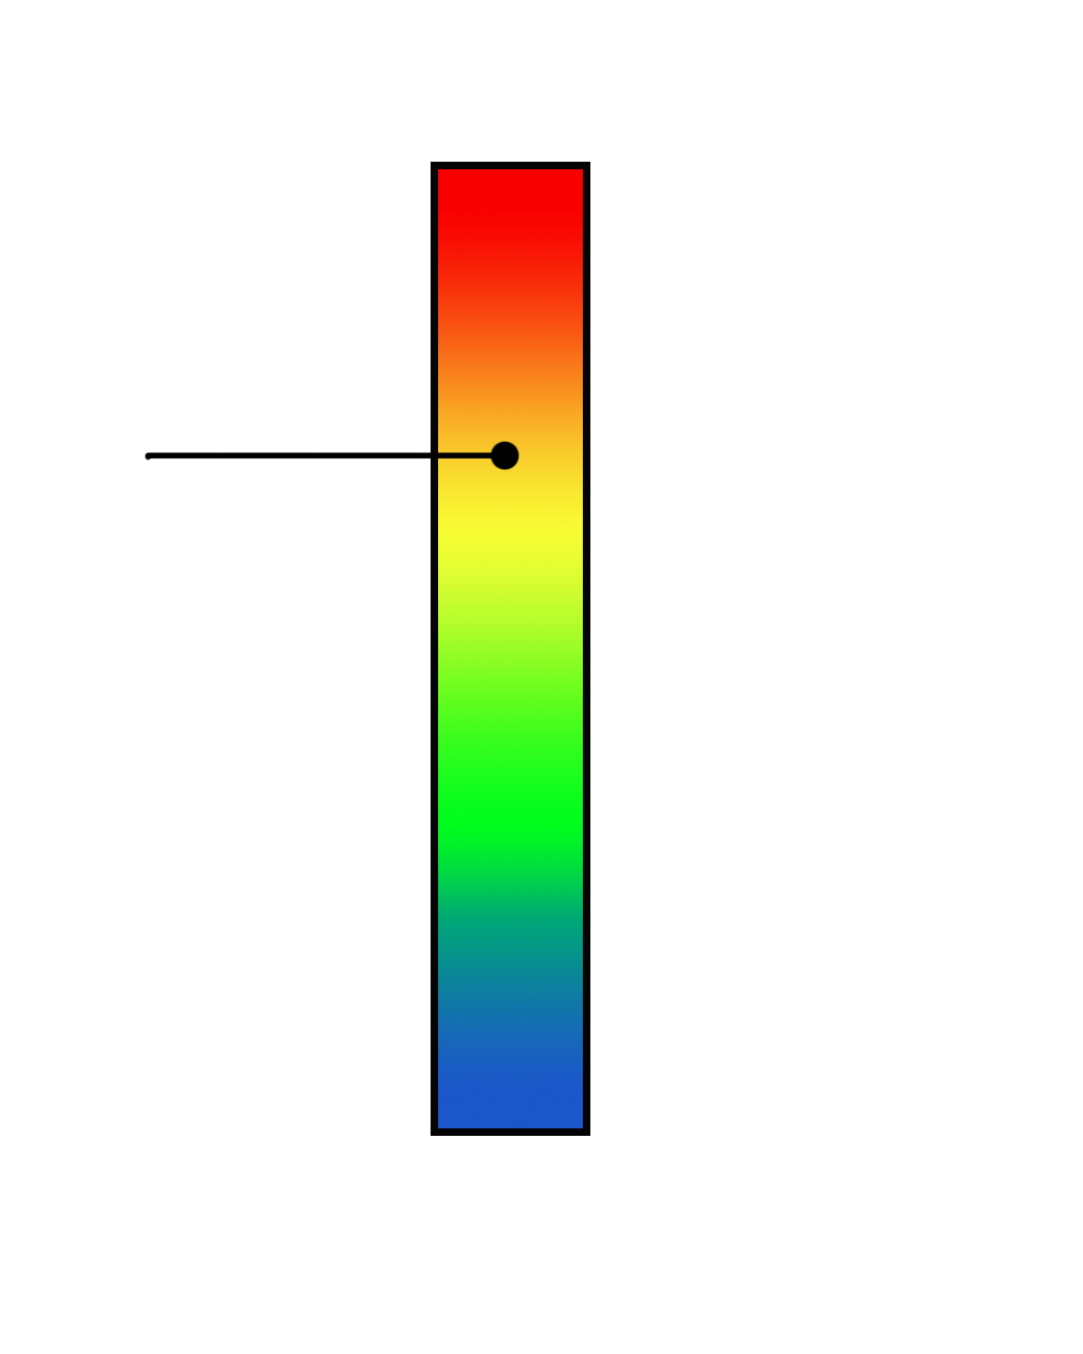

-O3: EVEN MORE OPTIMIZATIONS
The Animal Scale of Runtime Quickness
add more aggressive optimizations
Effects:
larger executables
depending on instruction cache size, may run more slowly
(no guaranteed speedup)

Slide 27
-O3: Loop Optimizations
The Animal Scale of Runtime Quickness
loop-interchange: discussed in lecture
unswitch-loops: move branches with loop invariant conditions out of the loop
duplicates of the loop in both branches (if and else)
increases code size, but can now optimize each loop separately
peel-loops: move a couple iterations out of the loop
simplifies the loop
Notes:
Unswitch-loops, tree-loop-vectorize/distribution/distribution-patterns, loop-interchange, peel-loops

Slide 28
-O3: Loop Optimizations
The Animal Scale of Runtime Quickness
loop-interchange: discussed in lecture
unswitch-loops: move branches with loop invariant conditions out of the loop
puts duplicates of the loop in both branches (if and else)
increases code size, but can now optimize each loop separately
peel-loops: move a couple iterations out of the loop
simplifies the loop
Notes:
Unswitch-loops, tree-loop-vectorize/distribution/distribution-patterns, loop-interchange, peel-loops

Slide 29
Loop Unswitching Example
int i, A[500], B[500];
bool c;
for (i = 0; i < 500; i++) {
A[i] += B[i]
if (c)
B[i] = 0;
}
Notes:
The if statement’s condition is loop invariant (doesn’t depend on i, or any value calculated using i)

Slide 30
Loop Unswitching Example
int i, A[500], B[500];
if (c) {
for (i=0; i < 500; i++) {
A[i] += B[i];
B[i] = 0;
}
}
else {
for (i=0; i < 500; i++) {
A[i] += B[i];
}
}
int i, A[500], B[500];
bool c;
for (i = 0; i < 500; i++) {
A[i] += B[i]
if (c)
B[i] = 0;
}
Notes:
Unswitch-loops, tree-loop-vectorize/distribution/distribution-patterns, loop-interchange, peel-loops

Slide 31
-O3: Loop Optimizations
The Animal Scale of Runtime Quickness
loop-interchange: discussed in lecture
unswitch-loops: move branches with loop invariant conditions out of the loop
duplicates of the loop in both branches (if and else)
increases code size, but can now optimize each loop separately
peel-loops: move one or more iterations out of the loop
simplifies the loop
Notes:
Unswitch-loops, tree-loop-vectorize/distribution/distribution-patterns, loop-interchange, peel-loops

Slide 32
Loop Peeling Example
int i, A[10], B[10];
int c = 5;
for (i = 0; i < 10; i++) {
A[i] = B[i] + B[c];
c = i;
}
Notes:
c=5 and then every iteration after that, c = i-1

Slide 33
Loop Peeling Example
int i, A[10], B[10];
int c = 5;
for (i = 0; i < 10; i++) {
A[i] = B[i] + B[c];
c = i;
}
int i, A[10], B[10];
A[0] = B[0] + B[5];
for (i = 1; i < 10; i++) {
A[i] = B[i] + B[i-1];
}
Notes:
Unswitch-loops, tree-loop-vectorize/distribution/distribution-patterns, loop-interchange, peel-loops

Slide 34
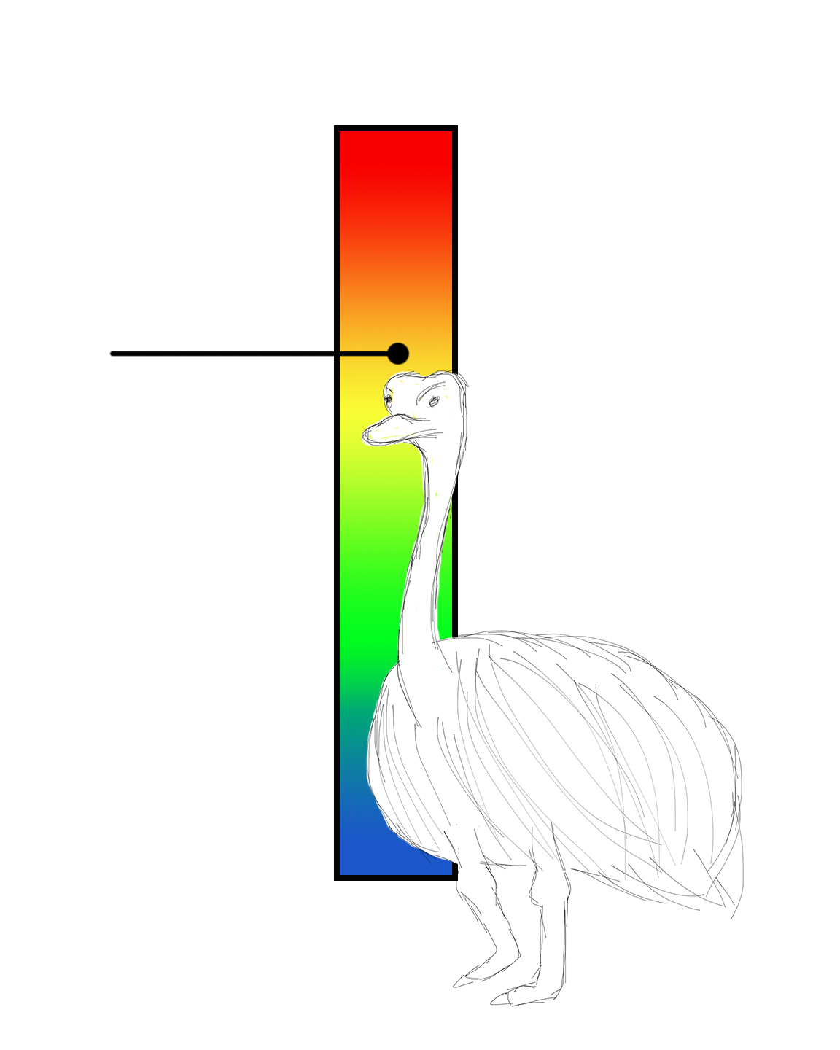
Predictive Commoning
The Animal Scale of Runtime Quickness
predictive-commoning: reusing computations from previous loop iterations
reduces memory accesses
for (int i = 0; i < 10; i++)
A[i+2] = A[i] + A[i+1];
load
load

Slide 35
Predictive Commoning
The Animal Scale of Runtime Quickness
predictive-commoning: reusing computations from previous loop iterations
reduces memory accesses
for (int i = 0; i < 10; i++)
A[i+2] = A[i] + A[i+1];
a0 = A[0];
a1 = A[1];
for (int i = 0; i < 10; i++) {
A[i+2] = a2 = a0 + a1;
a0 = a1;
a1 = a2;
}
Notes:
Start with two initial loads (outside loop); then, no loads within the loop (only copies)

Slide 36
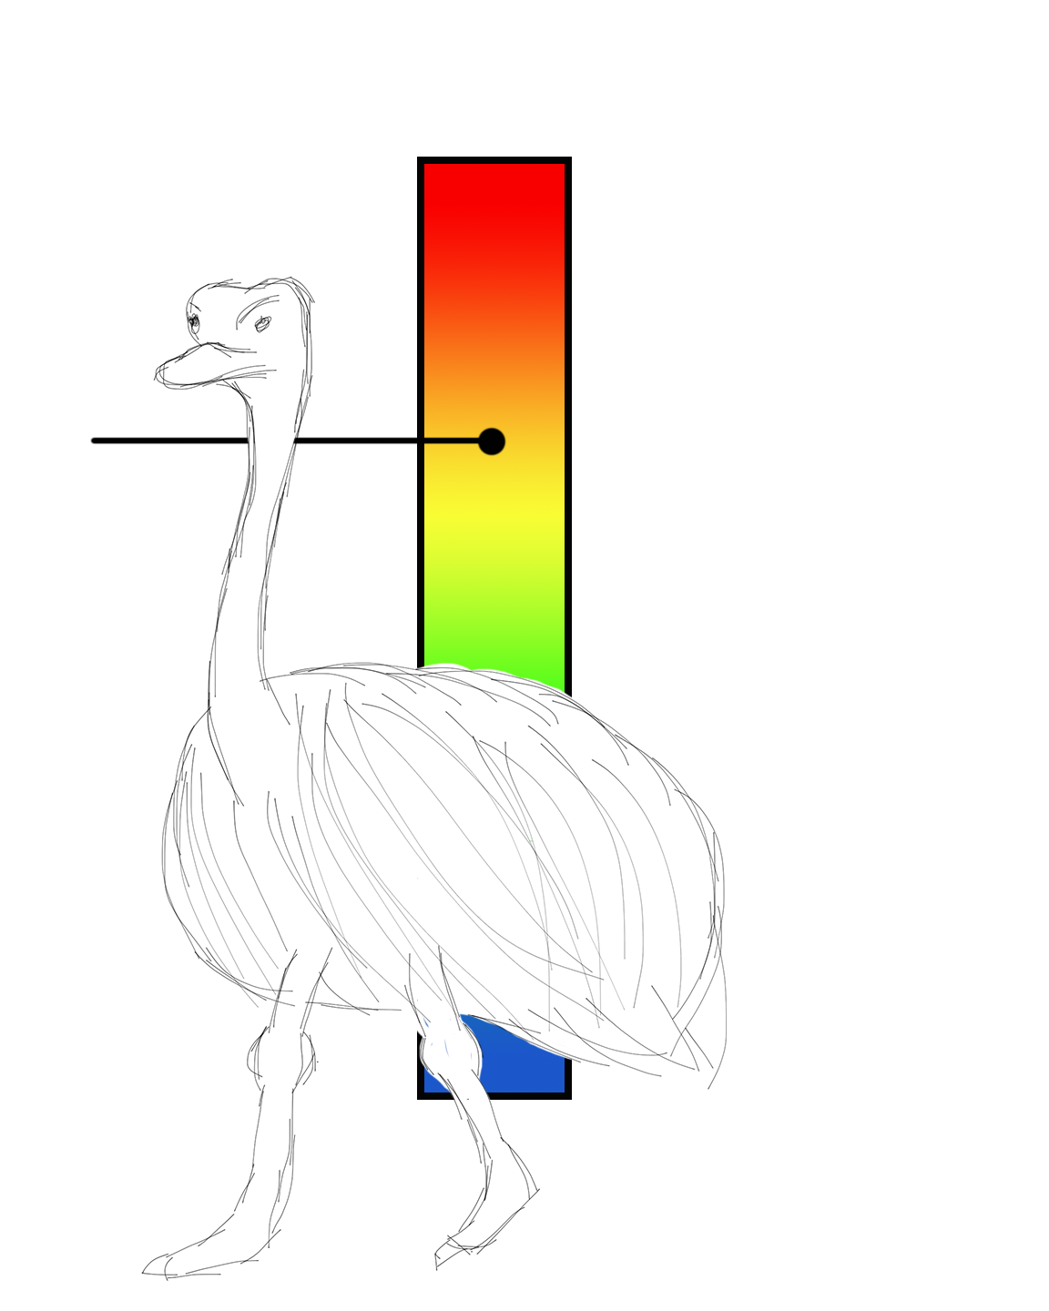
-O3: IPA Additions
The Animal Scale of Runtime Quickness
ipa-cp-clone: function cloning
improves constant propagation
done when externally-visible function can take constant arguments
compiler notices if we’re calling a function often with the same argument(s)
cloning functions may result in much larger code size/executables

Slide 37


Slide 38
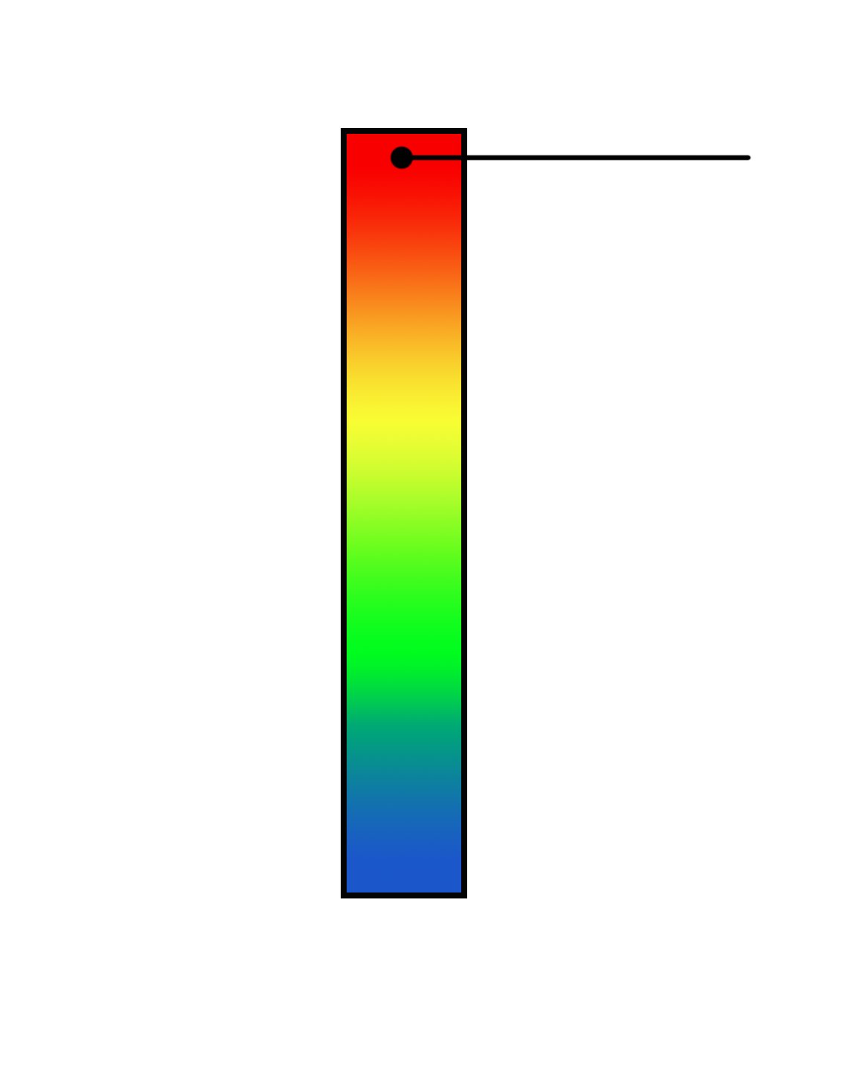

-Ofast: Optimizing for Speed
The Animal Scale of Runtime Quickness
Enables all -O3 optimizations
Plus some that are invalid for standards-compliant programs
May result in incorrect code
Notes:
May result in incorrect code, particularly revolving around floating point calculations

Slide 39

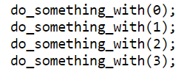
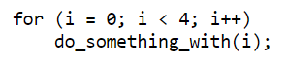
-Os: Optimizing for Size
Optimizes for code size
All O2 included except alignment-optimizations
Useful for machines that have limited disk space and/or small cache sizes
Counter example:
Loop unrolling
I’m small!
⇒
= Not small!
Notes:
Optimizes for space usage (code and data) of resulting program.
This includes all second-level optimizations, except for the alignment optimizations. The alignment optimizations skip space (using no-ops) to align functions, loops, jumps and labels to an address that is a multiple of a power of two, in an architecture-dependent manner. Skipping to these boundaries can increase performance as well as the size of the resulting code and data spaces; therefore, these particular optimizations are disabled.
“In some situations, optimizing for space can also produce faster code. In a sense, we are all running space-constrained systems, in that the performance of our CPUs depends heavily on how well those CPUs are using their cache space. Space-optimized code can make better use of scarce instruction cache space, and, as a result, perform better overall.” (https://lwn.net/Articles/534735/)

Slide 40
Machine-specific Optimizations
Modern processors depend on compiler optimizations for optimal performance
Optimizations exploit things such as memory addressing, flags, and register number and width
Machine-dependent optimizers make efforts to take maximum advantage of the memory hierarchy
(not pictured)
Notes:
Code improvements such as register allocation and instruction scheduling are machine dependent. In the case of register allocation, the types and number of registers available affects the promotion of data to registers. Similarly, effective instruction scheduling requires information about the operation of the target machine’s pipeline. Somewhat less obvious, but no less machine dependent are the code improvements inline function expansion and loop unrolling. Inline function expansion can be performed most effectively when details of the target machine’s instruction cache is available. Similarly, the amount of loop unrolling performed depends on the number of target machine registers available, characteristics of the instruction pipeline as well as the size of the instruction cache

Slide 41
Machine-specific Optimizations Cont.
Processor Specific Options
-mtune:
Generates code that works on any in the CPU family, but will favor the specified CPU
-march:
Will work on specified CPU, but typically not on earlier versions
Implies -mtune option
Both favor instruction sequences that run fastest on the specific CPU indicated
(not pictured)
Notes:
If you use -march then GCC will be free to generate instructions that work on the specified CPU, but not on (typically) earlier CPUs in the architecture family. If you use -mtune, then the compiler will generate code that works on any of them, but will favour instruction sequences that run fastest on the specific CPU you indicated.
As new processors are deployed in the marketplace, the behavior of these options will change. Therefore, if you upgrade to a newer version of GCC, code generation controlled by these options will change to reflect the most current processors at the time that version of GCC is released.

Slide 42


The Project

Slide 43
Motivation
Evaluation of GCC Optimization Parameters [1]
Has GCC become a better architecture specific optimizer over the last decade?
Experiment:
Test executed on two different machines
Modern Processor ⇒ Intel core i7 – 2630QM
Older Processor ⇒ Intel P4
Compiled SPEC CPU2006 Integer Suite using O1, O2, O3, and mtune optimizations
Calculated geometric mean of all workload speedups to determine best optimization level
Notes:
R. D. Escobar, A. R. Angula, and M. Corsi, “Evaluation of GCC Optimization Parameters”, in Ing. USBMed, Vol. 3, No.2, 2012, pp. 31-39. [Online]. Available: http://web.usbmed.edu.co/usbmed/fing/v3n2/v3n2a4.pdf.
Why study compilers?? ⇒ Speed of System = hardware + compilers. Very important for those concerned about performance.
Intel core i7 = multi-core / multi-threaded
Intel P4 = single-core / single-threaded

Slide 44
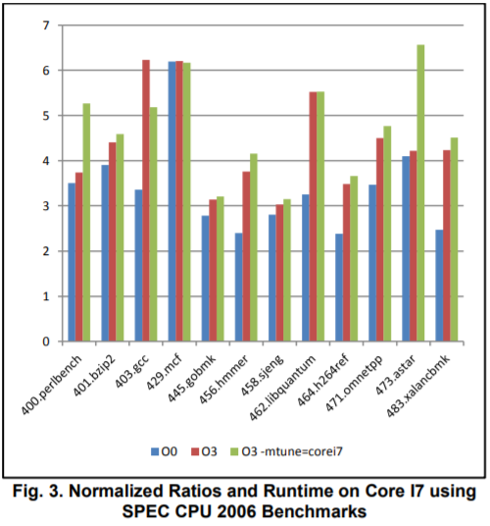
Motivation Cont.
Results:
As expected, a big speedup was seen when using O3
mtune + O3 for the more modern processor did not yield the expected speed up
Biggest factor = Major page faults
Notes:
Only 473.astar (path finding algorithm) produced predicted results of using mtune + O3 for modern processor.
Specific processor tuning (mtune) for GCC showed big performance increases relative to baseline and O3 testing for the dual core processor and huge increases for the i7. Path finding algorithms revolve around recursive coding which is highly threadable. Each of the later processors has an increasing amount of hardware threads when compared to Machine C. The basic blocks for this test are not modified greatly during the O3 optimization stage so loop unrolling does not produce a sizable performance gain, however the mtune tests show slight gains in the dual core which is capable of spawning 4 simultaneous hardware threads and huge gains when placed on the highly threaded quad core processor. [1]

Slide 45
Future/Project Plans
Goals:
How do the different optimizations perform on different systems?
Heracles: Intel Xeon E5-2650v4 Processors
Hydra: AMD Opteron 2427 Processors
Analyze the resulting
Number of page faults
Number of cache misses
Compilation time
Total memory usage
Code size
Program execution time
Notes:
Performance analysis with perf ⇒ https://perf.wiki.kernel.org/index.php/Main_Page

Slide 46
Future/Project Plans
Experiment:
Use built in Linux tools for analysis
time
perf
Tests will be scoped to a certain class of programs and executed against O1, O2, O3, Os, and mtune compiler optimizations
Tests will be executed on both Hydra and Heracles systems
Expected Results:
O3 optimization will result in the fastest execution time for most programs
The use of mtune will result in only moderate speedup gains for both systems
The higher the number of compiler optimizations, the longer the compilation will take

Slide 47
Questions?
Notes:
Benchmarks - SPEC ?
Traces
Possibly using perf for program execution analysis?
How do we plan on drawing conclusions / making comparisons between levels
Etc

Slide 48
References
R. D. Escobar, A. R. Angula, and M. Corsi, “Evaluation of GCC Optimization Parameters”, in Ing. USBMed, Vol. 3, No.2, 2012, pp. 31-39. [Online]. Available: http://web.usbmed.edu.co/usbmed/fing/v3n2/v3n2a4.pdf.
J. Pallister, S. Hollis, and J. Bennett, “Identifying Compiler Options to Minimise Energy Consumption for Embedded Platforms,” Department of Computer Science, University of Bristol, UK. 2013. [Online]. Available: https://arxiv.org/pdf/1303.6485.pdf.
Z. Pan and R. Eigenmann, “Fast and Effective Orchestration of Compiler Optimizations for Automatic Performance Tuning,” Proceedings of the International Symposium on Code Generation and Optimization. 2006.
J. Kaur and A. Kaur, “Role of Compiler in Computer Architecture,” International Journal of Engineering Research and General Science, Vol. 4, Issue 4, 2015, pp. 247-254. [Online]. Available: http://pnrsolution.org/Datacenter/Vol4/Issue3/33.pdf.
Jones, M. (2005). Optimization in GCC. [online] linuxjournal. Available at: http://www.linuxjournal.com/article/7269?page=0,0.

